Slide 1
Interface, Component, Database Design

Slide 2
Interface Design:
Concept: Focuses on the interaction between the user and the system or between system components.
Examples:
User Interface (UI): Design of forms, buttons, or layouts that users interact with.
Application Programming Interface (API): Defines how different software components interact (e.g., REST API for web services).
Key Principles:
Simplicity: Easy to use.
Consistency: Uniform across the system.
Responsiveness: Quick feedback to user actions.

Slide 3
Component Design:
Concept: A component is a modular, reusable part of a system that encapsulates functionality.
Examples:
Login Component: Handles user authentication.
Cart Component: Manages items in an e-commerce cart.
Design Goals:
Reusability: Can be used in multiple applications.
Modularity: Works independently of other components.

Slide 4
Database Design:
Concept: Structuring the database to store and manage data efficiently.
Steps:
Identify entities (e.g., Users, Orders).
Define relationships (e.g., User places Orders).
Normalize data to avoid redundancy.
Example: In an e-commerce database:
Users Table: Stores user information.
Orders Table: Tracks orders.
Products Table: Contains product details.

Slide 5
Design Patterns

Slide 6
What is a Design Pattern?
A Design Pattern is a reusable solution to a common problem in software design. It shows how objects and classes work together to solve a specific design problem in a structured way.
Why Use Design Patterns?
To save time by reusing proven solutions.
To improve code quality, readability, and maintainability.
To create scalable and flexible systems.

Slide 7
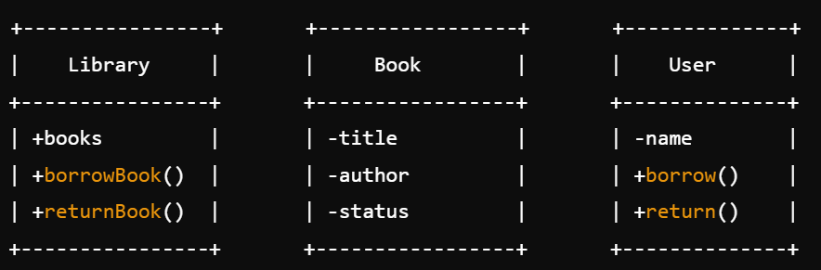
How Objects and Classes Work Together
Example: Library System
Problem: Manage borrowing and returning books in a library.
Classes:
Library: Manages books.
Book: Represents a single book.
User: Represents a library user.
Interaction:
The User borrows a book.
The Library checks if the book is available.
If available, the Book's status is updated to "borrowed."

Slide 8
Types of Design Patterns
Creational Design Patterns
Purpose: Helps in creating objects without directly specifying their class or the creation process.
Examples:
Singleton Pattern: Ensures only one instance of a class exists.
Example: A Logger class that maintains one log file for the entire application.
Real-Life Analogy: A printer queue managed by one manager.
Builder Pattern: Creates complex objects step-by-step.
Example: Assembling a car (engine, tires, etc.).
Real-Life Analogy: Building a custom pizza (choose crust, sauce, toppings).
When to Use:
Singleton: When only one instance of a class is required.
Builder: For creating complex objects step-by-step.

Slide 9
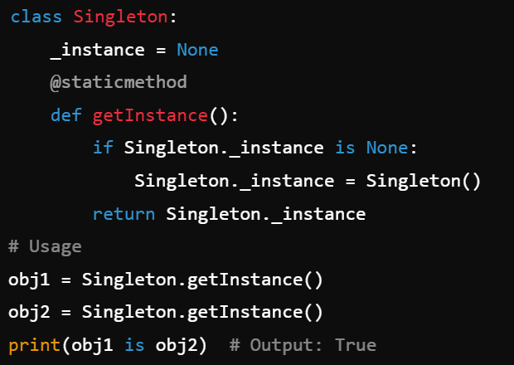
Creational Design Pattern..

Slide 10
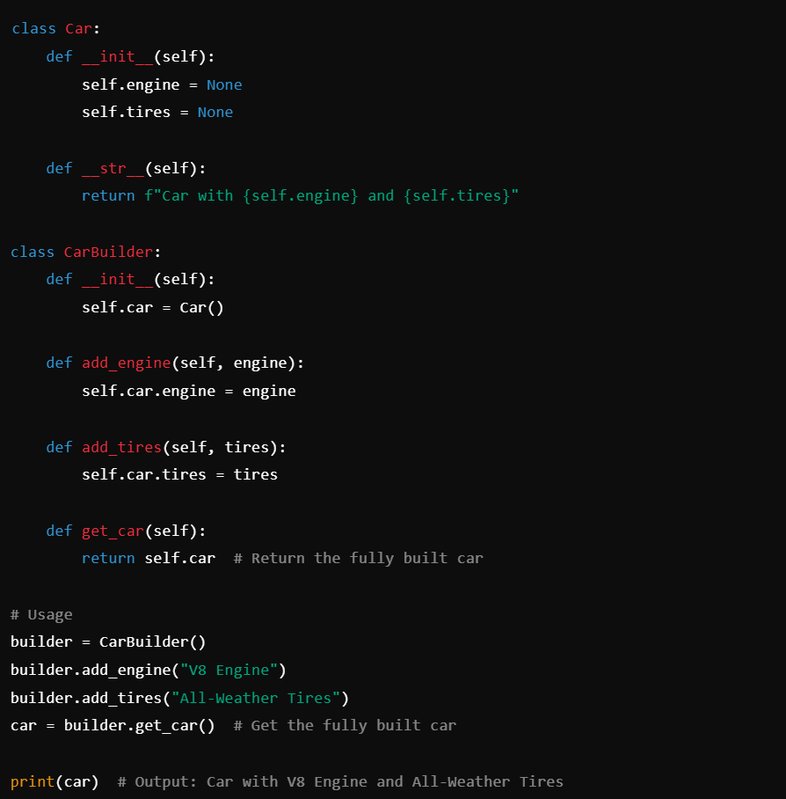
Creational Design Pattern..

Slide 11
Structural Design Patterns
Purpose:
Focuses on organizing classes and objects into larger structures.
Adapter Pattern
What It Does: Converts one interface into another, making incompatible systems work together.
Real-Life Example: A power adapter lets you plug a European device into an Indian socket.
Software Example: Connecting legacy systems to modern APIs using an adapter.
Decorator Pattern
What It Does: Adds new functionality to an object dynamically without modifying its structure.
Real-Life Example: Adding extra toppings to ice cream.
Software Example: Dynamically adding a scrollbar to a window.
When to Use Structural Patterns:
Adapter: When integrating existing systems or third-party libraries.
Decorator: When adding new features to an object dynamically.

Slide 12
Behavioural Design Patterns
Purpose:
Defines how objects communicate and interact with each other.
Observer Pattern
What It Does: Notifies multiple objects when another object changes.
Real-Life Example: YouTube subscriptions – Users get notified when a new video is uploaded.
Software Example: A weather app updates all users when the weather changes.
Strategy Pattern
What It Does: Lets you choose between multiple algorithms at runtime.
Real-Life Example: Choosing a route on Google Maps (shortest, fastest, avoid tolls).
Software Example: Applying different sorting algorithms based on the dataset size.
When to Use Behavioral Patterns:
Observer: When multiple objects depend on a single object’s state.
Strategy: When algorithms need to change dynamically.

Slide 13
